Slide 1
Human resource management and selection
Session 15

Slide 2
Staffing
Filling positions in the organization structure through identifying work force requirements, inventorying the people available, recruiting, selecting, placing, promoting, appraising, compensating and training.

Slide 3
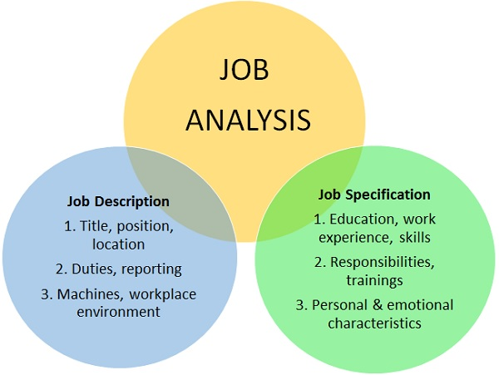

Slide 4
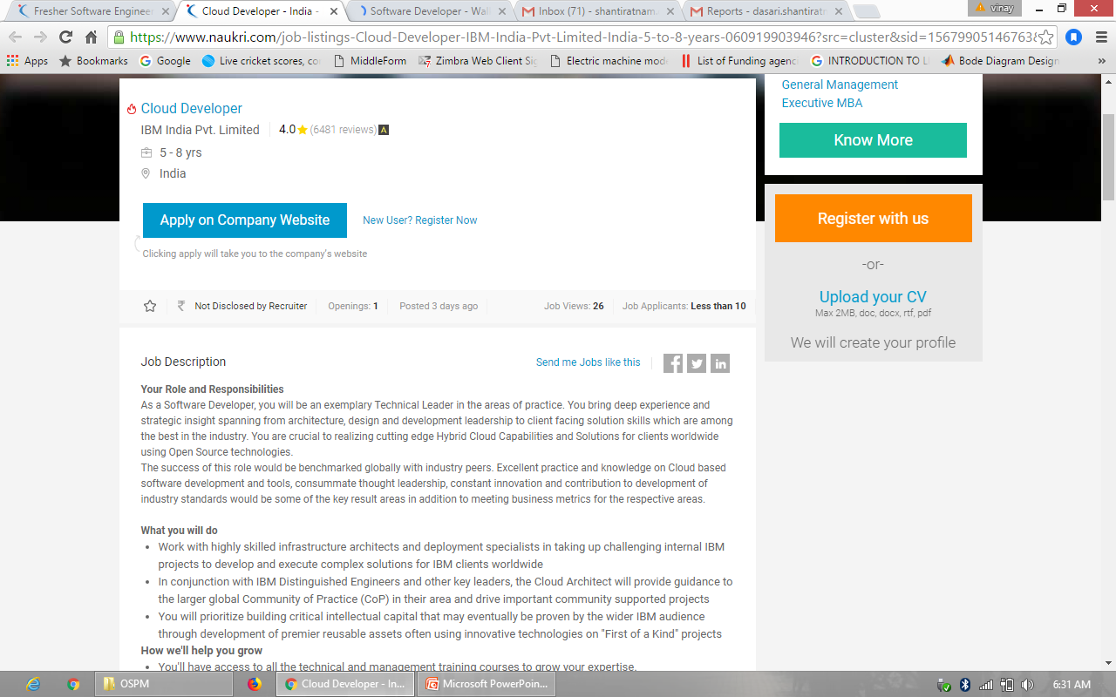

Slide 5
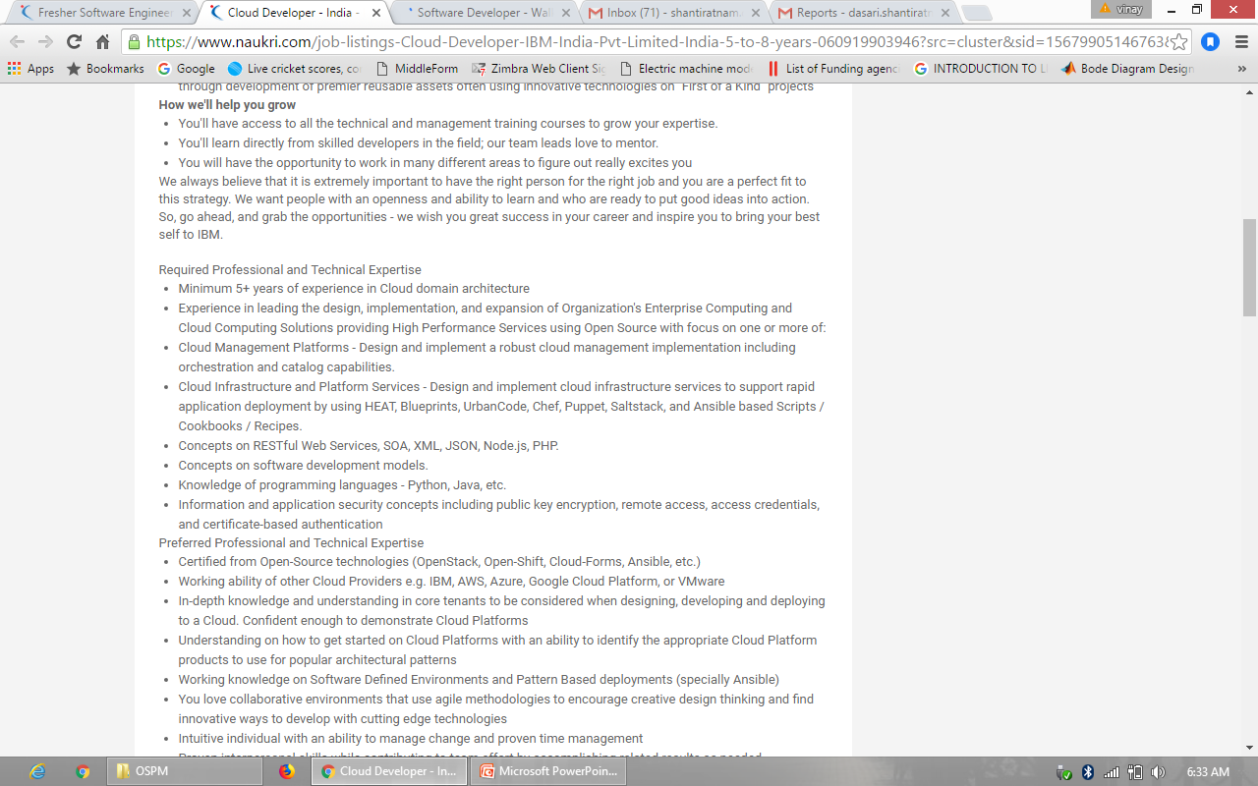

Slide 6
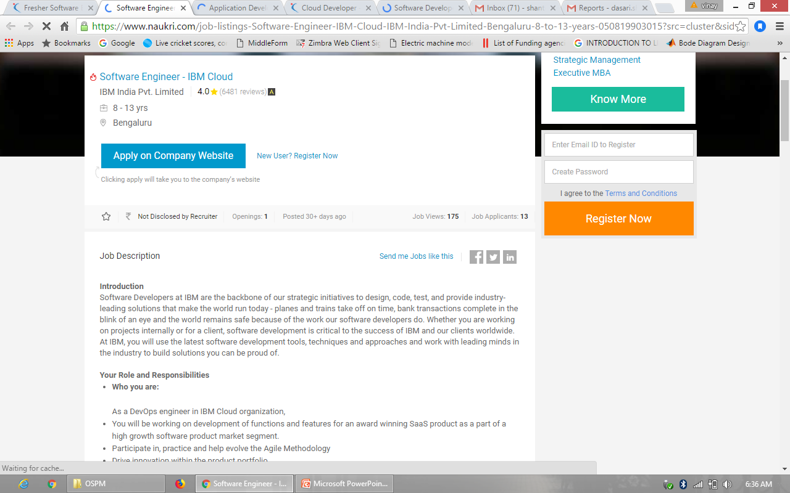

Slide 7
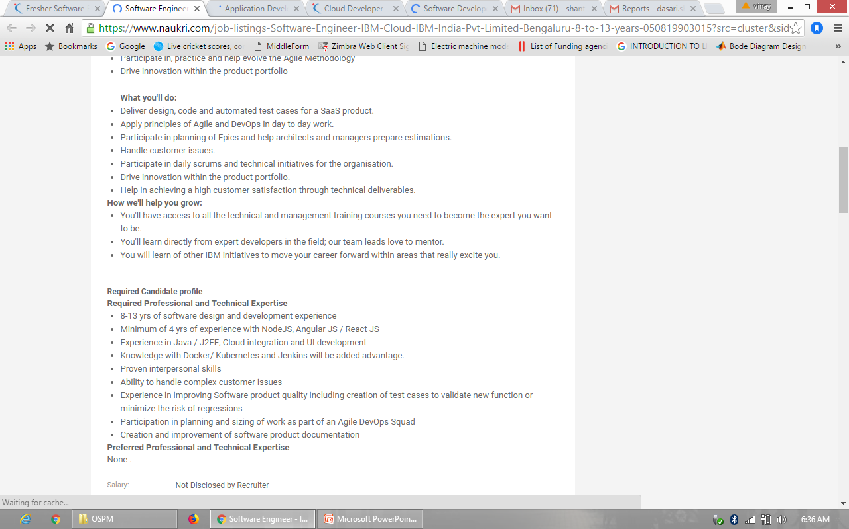

Slide 8
Recruitment
“Recruitment” is the process of finding and hiring the best and most qualified candidate for a job opening, in a timely and cost-effective manner. It can also be defined as the “process of searching for prospective employees and stimulating and encouraging them to apply for jobs in an organization”.

Slide 9
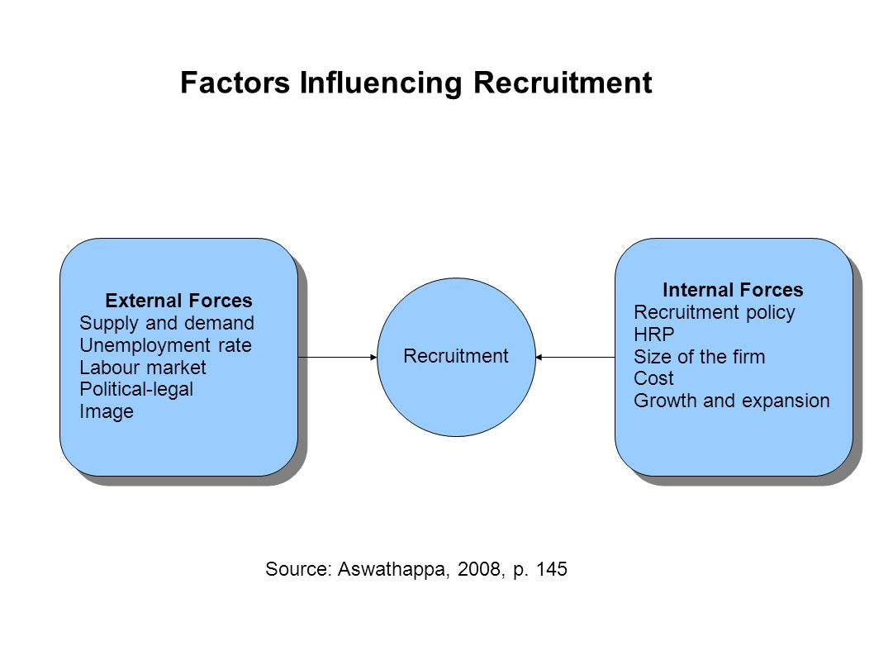

Slide 10
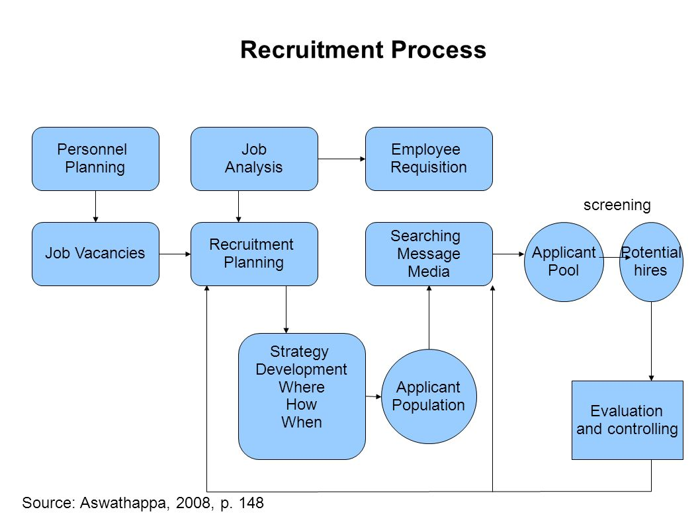

Slide 11
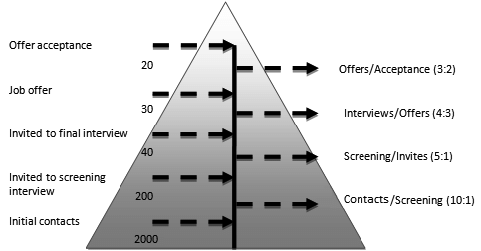
Recruitment planning(Number and types)

Slide 12
Sources of recruitment(How to look)
Internal Sources of Recruitment:
Present employees
Employee referrals
Former employees
Previous applicants

Slide 13
External sources of recruitment:
Advertisements
Employment exchanges
Campus recruitment
Walk-ins
Recruitment consultancies
Contractors
Displaced persons
Radio and television
Acquisitions and mergers
Competitors
E-Recruiting

Slide 14
Selection
It is the process of differentiating between applicants in order to identify and hire those with a greater likelihood of success in a job.

Slide 15
Types of costs
1. First type is incurred while the person is employed.
This can be the result of production or profit losses, damaged company reputation, accidents due to negligence, absenteeism.
The second type of costs is associated with the training, transfer or terminating the services of the employee.
Third type of cost constitutes the replacement of an employee with a fresh one-costs of hiring, training and replacement.

Slide 16
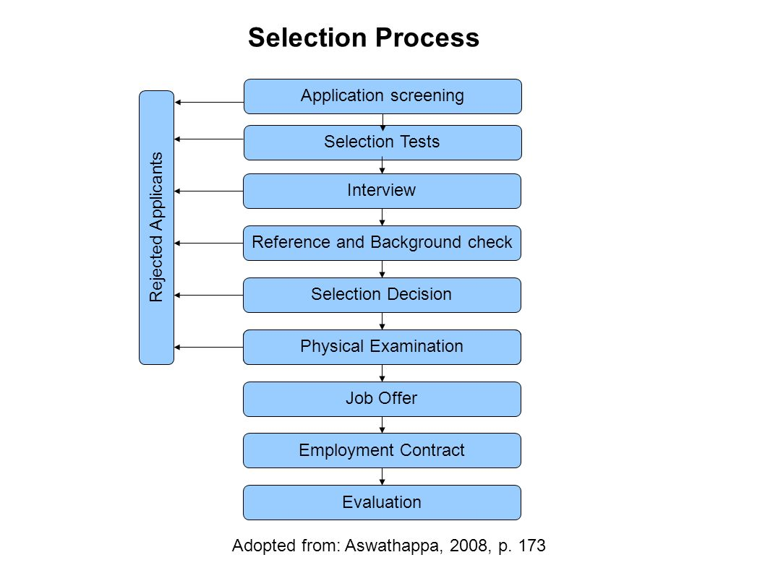
Selection process

Slide 17
Types of interviews
Telephone interview
Video conferencing
One-to-one interview/ Face-to-face interview
Panel interview
Group interview
Sequential/ Serial interview

Slide 18
Five stages of Google’s selection Process
1. When a job opening is announced job resumes will flow in from all directions of the globe. Roughly out of 500,000 applications the HR team will review these applications and bring the figure down to 40,000 by rejecting the less competent ones.
2. The recruiting team will start calling these 40,000 applicants over the phone and out of which 1,500 candidates shall be shortlisted.
3. The 1,500 shortlisted candidates will be called in for an on-site interview out of which 1,300 shall be rejected.
4. Finally the recruiting team will be left with 200 proficient applicants whom will be directed to the hiring committee.
5. The final decision is to be made by the hiring committee, who will make the decision depending on the number of vacancies and the requirement of the job role.

Slide 19
TCS Recruitment and selection process
The TCS recruitment process consists of four rounds of selection and includes a written exam, technical interview, managerial interview and HR interview. In order to be eligible you need to have a minimum of 60% throughout your degree with no backlog. A gap in career up to a maximum of two years is permissible but with a valid explanation.

Slide 20
HCL Academic criteria
Academic Criteria
HCL recruitment process requires the students to have at least 60% in their 10th, 12th and Graduation.
A maximum gap of 1 year is permissible after HSC(12th) and not after SSC(10th) or in between semesters of graduation to sit for HCL Recruitment.
A candidate should not have any pending backlogs at the time of appearing for HCL selection process.

Slide 21
HCL Recruitment policy
HCL Recruitment for Freshers is an extensive process consisting of 4 rounds. Remember that all these rounds are very crucial for your success in HCL Recruitment. These rounds for HCL Selection Process are generally held within a span of 2 days but might vary for some colleges.
Following rounds take place in HCL Recruitment for Freshers:
HCL Aptitude Test
Group Discussion
Technical Interview
HR Interview
Note that the 1st two rounds of HCL recruitment are an elimination round.

Slide 22
Orientation and socializing New employees
Orientation: The introduction of new employees to the enterprise-its functions, tasks and people.
Organizational socialization: Is the process through which a newcomer to an organization transitions from outsider to integrated and effective insider. This longitudinal process includes the acquisition or adjustment of shared values, attitudes, skills, knowledge, abilities, behaviors, and workplace relationships.

Slide 23
Training
Training refers to a systematic setup where employees are instructed and taught matters of technical knowledge related to their jobs. It focuses on teaching employees how to use particular machines or how to do specific tasks to increase efficiency.

Slide 24
Development
Human resource development is the integrated use of training, organization, and career development efforts to improve individual, group, and organizational effectiveness. HRD develops the key competencies that enable individuals in organizations to perform current and future jobs through planned learning activities.

Slide 25
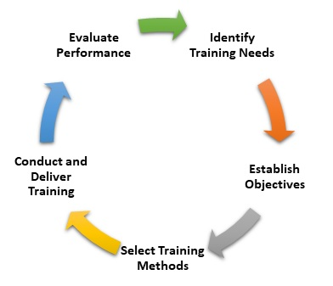
Training process

Slide 26
